Slide 1
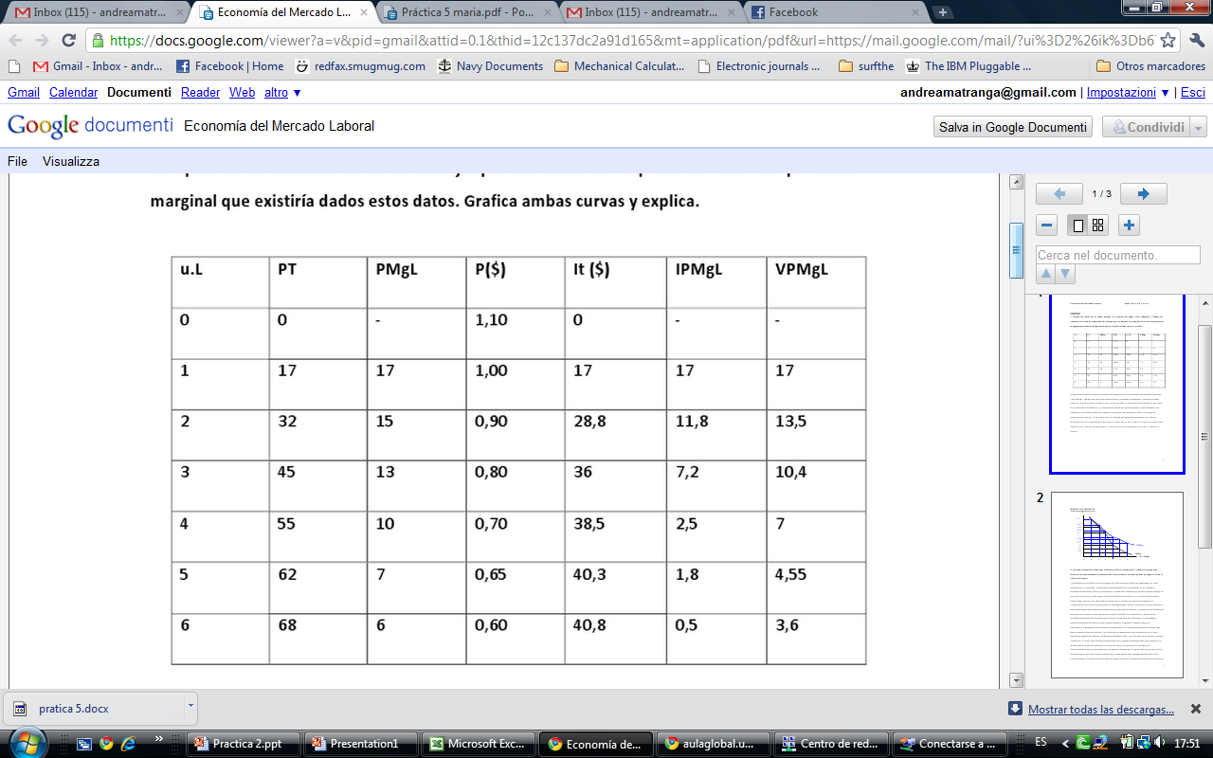
UL | TP | MPL | P($) | TR($) | MRPL ($) | VMRP ($)
1
32-17=
28,8-17=
55x0,70=
6x0,60=

Slide 2
1

Slide 3
Let’s take the table from the first question
Let’s assume wages to be $12, then it will be good for society to employ the 2nd workers: spends $12 and produces $13.5. But the firm will not hire him, for prices will go down → the MRPL is only 11.8 , which is smaller than 12 (the firm is losing here!)
2
UL | TP | MPL | P($) | TR($) | MRPL ($) | VMRP ($)

Slide 4
Examples
2
Natural monopolies : railroads, water companies, electricity, army, justice.
Legislative monopolies : taxi drivers, exclusive licenses, mail. They are usually old natural monopolies which are now obsolete.
Illegal Monopolies: drug markets in some countries.

Slide 5
Solutions (?)
2
Price system: if prices are that enticing, others will eventually enter the market
Monopolies should disappear if markets are allowed to work
Natural monopolies are usually administered by the state (but, aren’t they costly for the state as well?)
Legislative monopolies are due to politics rather than economics. Those who reap the benefits are the politically well connected (“crony capitalism”)
Illegal monopolies → What if you legalize them?

Slide 6
2
In general, the cost of producing drugs is low, and “anyone” could do it. But when you have to add such things as security and bribes then it becomes expensive.
Why the benefits are significantly high?
  Cartels / monopolies

Slide 7
Perfect competition
3
If wages go from $6 to $10, employment goes from 450 to 310 (difference of 140)

Slide 8
Monopoly
3
If wages go from $6 to $10, employment goes from 310 to 250 (difference of 60)

