Slide 1
First question
In equilibrium:
MRPL = MWC
MRPL=20-0.5T=10
T= (10-20)/(-0.5)= 20
Answer: It will hire 20 workers

Slide 2
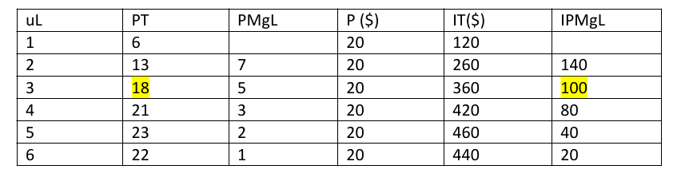
Second question
UL | TP | MPL | P($) | TR($) | MRPL ($)
6
120
-
1. LDR starts with the 3rd worker, since its contribution is smaller than the previous worker for the first time
2. The MPL of the 3rd worker is 5
3. The unit MRPL for pot 18th is the same as with the rest: 20!
4. True → The MRPL = MPL x unit MRPL (20)
5. The firm will hire 4 workers (the 5th has a MRPL = 40, and 40 < 50 and the firm is losing money!

Slide 3
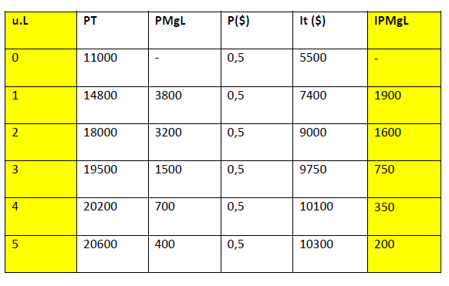
Third question
Answer: It will hire 3 overseers. If it hires more then MRPL = 350 < 500 = MWC
UL | TP | MPL | P($) | TR($) | MRPL ($)

Slide 4
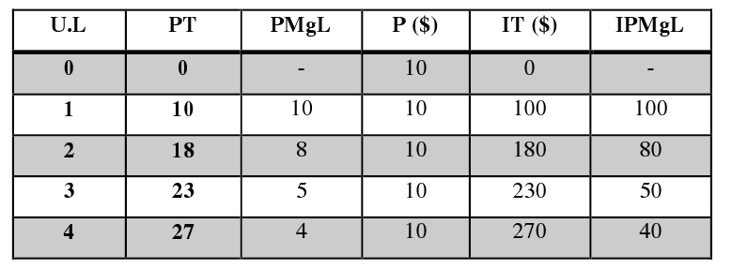
Fourth question
UL | TP | MPL | P($) | TR($) | MRPL ($)
A) Third column (MPL)
B) Yes. Every additional cook contributes with a lower output than before
C) Sixth column

Slide 5
Euros
If the vertical axis represents equilibrium wages, then the red line is the firm’s demand for labor
100
80
MRPL= Demand for labor
50
40
1
2
3
4
Workers
A maximizing competitive firm will employ up to 2 cooks, producing 18 cakes; not more, because it will lose money since MRPL < MWC. Notice that the firm can get the highest profit with either 1 or 2 workers

